Slide 1
JISEA Natural Gas Study: Potential U.S. Electric Power Futures
Drawing the Blueprint for a Sustainable Energy Future
Denver Museum of Science and Nature
Jeffrey Logan
January 18, 2012

Slide 2
Joint Institute for Strategic Energy Analysis
JISEA conducts leading-edge interdisciplinary research and provides objective and credible data, tools, and analysis to guide global energy investment and policy decisions.
The founding institutional partners of the Joint Institute include NREL, MIT, Stanford, CU Boulder, Colorado School of Mines, and Colorado State University.

Slide 3
Natural Gas and Electric Power Study
Initiated in summer 2011 with 8 sponsors and JISEA team
Preliminary results ready in March 2012, final report summer 2012
Three main areas of focus:
Lifecycle GHG assessment of unconventional gas
Harmonization of published results and potential bottom-up LCA
Trend assessment of regulations and BMPs in 6 basins
Incremental cost of operating at higher environmental standards
Electric power sector scenarios
How will gas supply, other policies and technology outcomes affect the transformation of the U.S. power sector (focus on achieving low carbon future)

Slide 4
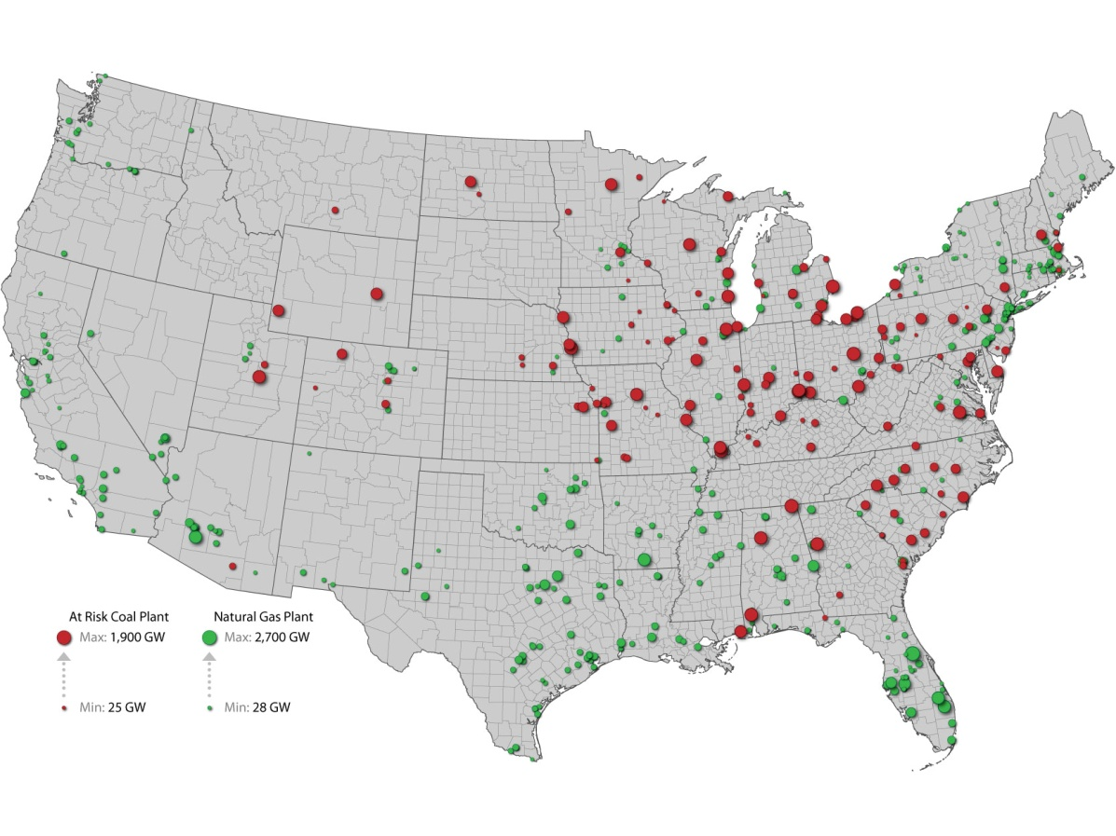
Impact of EPA Rules and LNG exports on Natural Gas Demand
Coal Plants Potentially at Risk of Retirement from EPA Regulations
MW
MW
MW
MW
Source: NREL 2010. For illustrative purposes only. Some of these “at risk” plants are now considered safe given the relative looseness of the 316(b) rule..
Notes:
Most constrained capacity is along ohio river valley (http://web.mit.edu/mitei/research/studies/documents/natural-gas-2011/NaturalGas_Chapter4_Electricity.pdf)
Chart on right gives example of how much more NG would be used under a variety of changes.

